Slide 1

13
Project Management
Organizational Structures

Slide 2
Chapter Concepts
The characteristics of the three types of organizational structures
The advantages and disadvantages of each
The role of a project management office

Slide 3
Learning Outcomes
Explain the three types of project management organizational structures
Discuss the advantages and disadvantages of each type of project management organizational structure
Describe the role of a project management office in a matrix organizational structure

Slide 4
Project Integration Management
Project Resource Management
Project Management Knowledge Areas from PMBOK® Guide

Slide 5
Functional Organizational Structure
Typically used in businesses that primarily sell and produce standard products
Work groups consist of individuals who perform the same function
Team members may be assigned to the project either full-time or part-time
The project manager does not have complete authority over the project team
Project manager regularly updates the other functional managers in the company on the status of the project

Slide 6
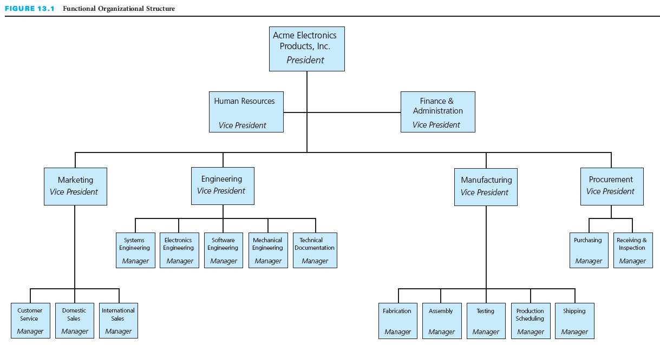
Industrial Business Example: Functional Organizational Structure

Slide 7
Autonomous Project Organizational Structure
Companies with this organization are in the projects business; they do not produce standard products
Company works on multiple projects at any given time; usually high dollar value and long term projects
As projects are completed, the company hopes to get new contracts for projects
Each project team is dedicated to only one project
Each project is operated like a mini-company
There is little opportunity for members of different project teams to share knowledge or technical expertise

Slide 8
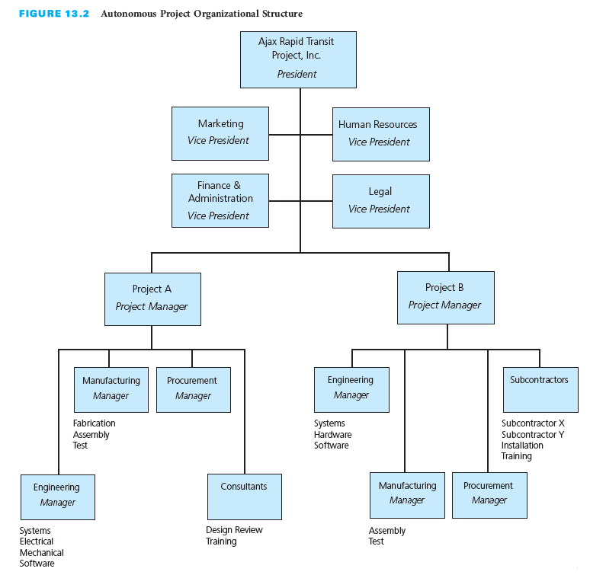
Rapid Transit Project Business Example: Autonomous Project Organizational Structure

Slide 9
Matrix Organizational Structure
Multiple projects are in progress at any given time, and these projects vary in size and complexity
Hybrid structure—a mix of both the functional and autonomous project organizational structures
Provides for effective utilization of company resources
  Employees assigned to the project for the length of time they are needed
  Pursue career development through assignment to various types of projects
  Have a dual reporting relationship—a (temporary) project manager and a (permanent) functional manager
Project manager is the intermediary between the company and the customer
Checks-and-balances and fast response upon problem identification

Slide 10
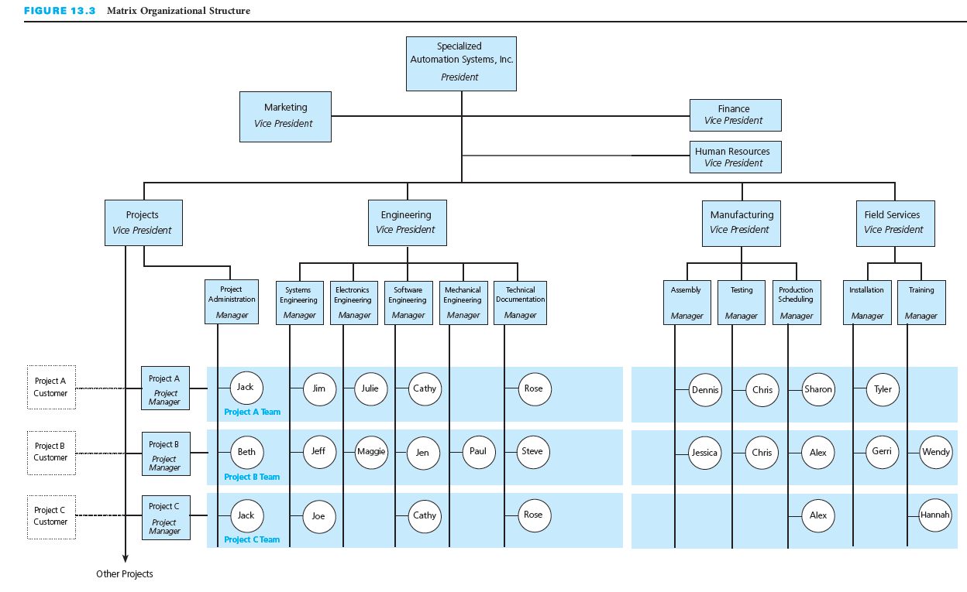
Custom Computer-Based Automation Systems Example: Matrix Organizational Structure

Slide 11
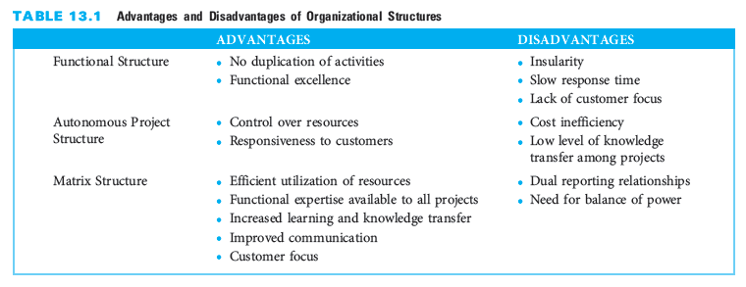
Advantages and Disadvantages of Organizational Structures

Slide 12
Critical Success Factors
In a matrix organization, it is important to delineate the project management responsibilities and the functional management responsibilities.
When implementing a matrix organizational structure, operating guidelines should be established to assure proper balance of power between project managers and functional managers.
Project teams should be kept as small as feasible throughout the project.

Slide 13
Summary
The three most common structures used to organize people to work on projects:
  The functional organizational structure is typically used in businesses that primarily sell and produce standard products. The advantages of a functional organizational structure are no duplication of activities and functional excellence. Disadvantages include insularity, slow response time, and lack of customer focus.
  The autonomous project organizational structure is used by companies that are working on multiple projects at any one time and do not produce standardized products. The advantages of the autonomous project organizational structure are control over resources and responsiveness to customers . Cost inefficiency and low level of knowledge transfer among projects are its disadvantages.

Slide 14
Summary (continued)
  The matrix organization is a hybrid of both the functional and the autonomous project organizational structures. The advantages of a matrix organizational structure include efficient utilization of resources, functional expertise available to all projects, increased learning and knowledge transfer, improved communication, and customer focus. Its disadvantages are the dual reporting relationships and the need for a balance of power.
In the matrix structure, the project manager is the intermediary between the company and the customer.
The project management office in the matrix organizational structure oversees and coordinates multiple projects.

